Slide 1
Unsupervised Time Series Anomaly Detection Peter Chen 10/1/2019

Slide 2
Project Overview
Proposal: R&D of unsupervised anomaly detection algorithms for time series data
Benchmark different unsupervised methods on open-source datasets
Develop methodology to use Autoencoders to perform anomaly detection
Only results on open source datasets will be shared with Georgia Tech. Benchmarks on internal datasets will not be shared for compliance purposes
Benefits
Successful ML model can save $ by preventing anomalies at UTC
Common code base can be applied to various anomaly detection problems at UTC
Datasets
Primary Dataset - Paper Mill Failure Dataset
Secondary Datasets – Credit Card Default, IBM IoT Dataset, Machine Failure Datasets

Slide 3
Current Status
Completed
Self-learning for autoencoders and unsupervised anomaly detection via online resources
Self-learning for tensorflow/keras toolkit for deep learning
Dataset selection and literature review – focus on time series anomaly detection datasets
Metric selection – Area Under Precision Recall Curve
Develop preliminary methodology for Autoencoders using reconstruction error
Benchmark autoencoder model and compare performance of different performance intervals and topologies
Benchmark autoencoder model performance to XGBoost (in paper) and K means clustering technique
Next Steps
Assess K means clustering on encoded layer outputs
Visualize encoded layers using T-sne visualizations – attempt to visually separate failures and non-failures
Try different aggregation techniques for reconstruction error such as standard deviation and median
Assess unsupervised + supervised techniques such as autoencoder + logistic regression
Self learnings on generative models – Generative Adversarial Networks and Variational Autoencoders
Benchmark model on additional datasets – compare performance
Develop reusable code-base for autoencoder anomaly detection

Slide 4
Anomaly detection
Traditional Anomaly Detection for Machine Data
Tiered alarm systems using expert set thresholds and statistical analysis of data
Challenges
Lots of manpower needed to set thresholds
Lack of failure data - class imbalance
High Dimensional – difficult to visualize
Non-stationary – changing contexts (ex. Different ambient conditions)
One size fits all thresholding technique is not ideal for non-stationary data
Potential Improvement
Unsupervised learning – Clustering/Autoencoders
Learn to model nominal behavior
Assess deviation for new data points to determine likelihood of anomaly

Slide 5
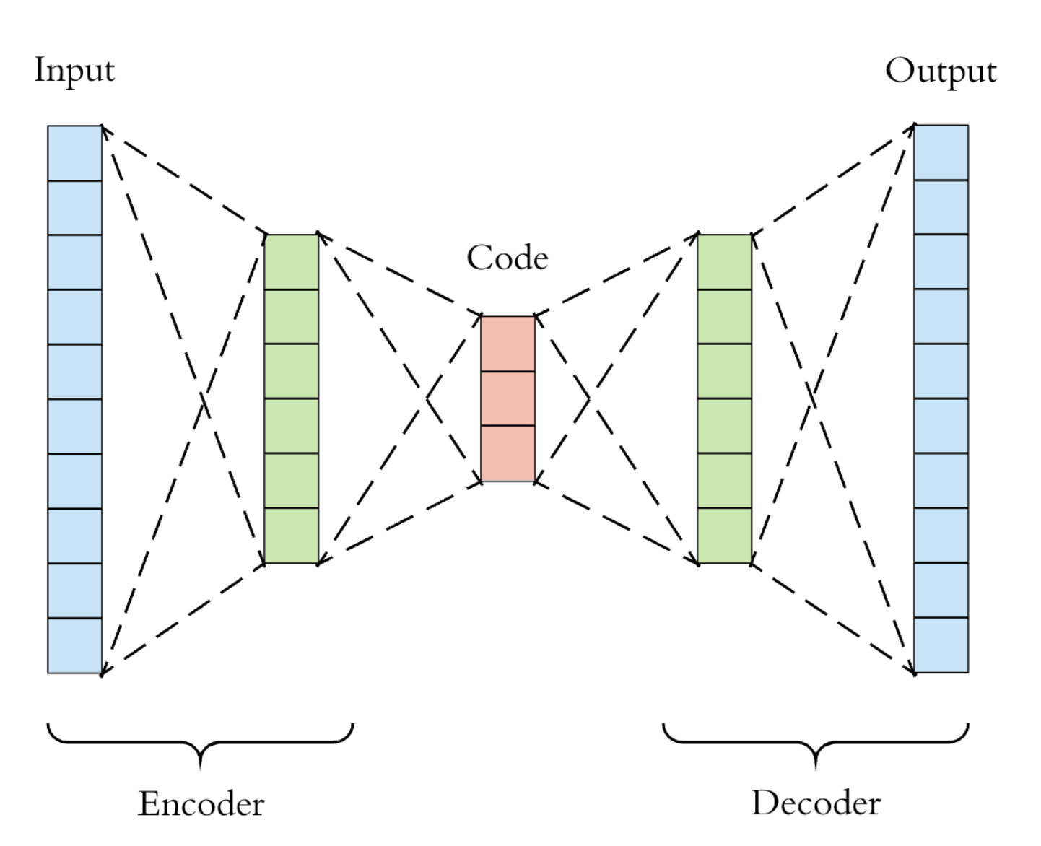
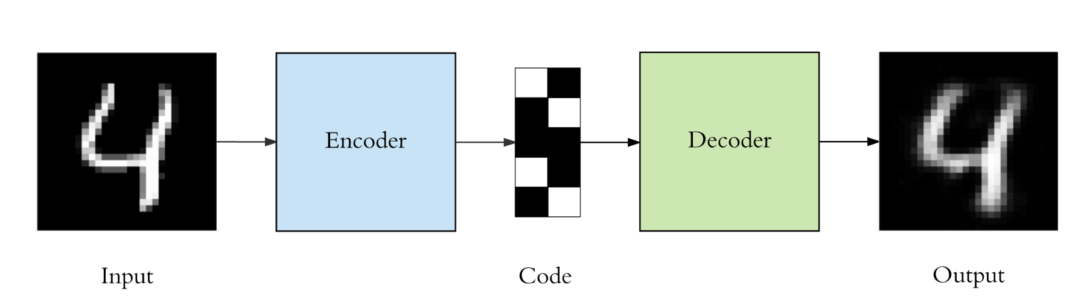
Autoencoders Overview
Autoencoder structure
Symmetric neural network where inputs = outputs
Encoder – Decoder system with a middle bottleneck layer for dimension reduction
Goal – Learn the intrinsic structure of the data by prioritizing the important information (code)
Key Assumption: Structure is different for nominal data vs anomalous data
Therefore, reconstruction error for anomalous data will be higher
Use the difference in error to detect anomalies
bottleneck
Example Use Case
784
10
784

Slide 6
Paper Mill Dataset

Slide 7
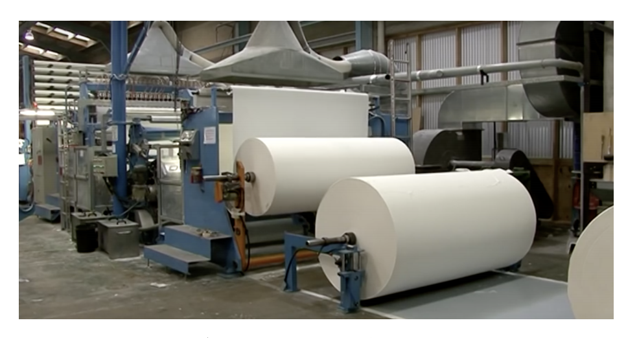
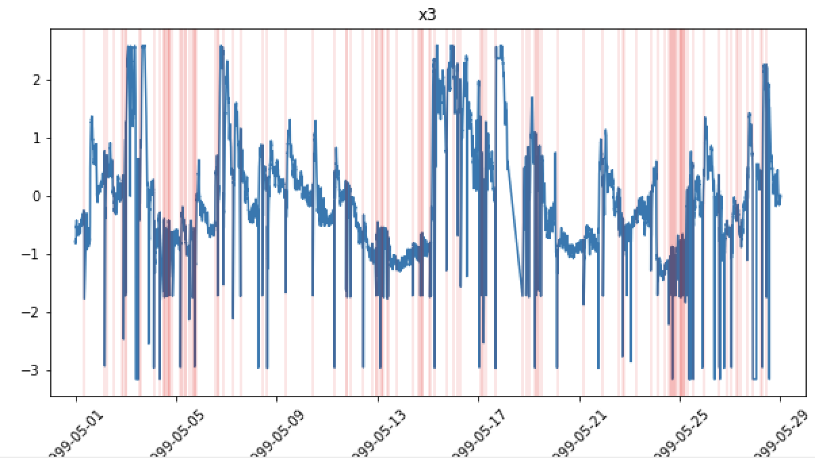
Open Source Dataset #1: Paper Mill Machine Sensors
https://arxiv.org/pdf/1809.10717.pdf
Data: Time series of paper mill machine with 60 sensor parameters and 1 binary target variable indicating failures
Failures represent when the machine breaks, breaks can take over 1 hour to resolve
Variables: Large class imbalance – 124 failure vs 18,274 non-failure points (failures in red)
Benchmark: In the paper, the best supervised model (XGBoost) had F1 score of .11
Sensor 3 out of 61

Slide 8
Simple Autoencoder for Paper Mill
Proposed Anomaly Detection Method
Input – 61 sensors
Train model on non-failure data
X = sensor inputs, y = sensor inputs
Set statistical threshold for nominal behavior based on training data's reconstruction error
try 3 sigma, 5 sigma, and max threshold
Predict on test data
Calculate reconstruction error for test data
Classify anomaly based on error threshold
Benchmark models based on area under Precision-Recall Curve. (ROC AUC is not suited for class imbalance)
Dense
(32 units)
Dense
(16 units)
bottleneck
Dense
(32 units)
Output – 61 sensors
Loss: mean squared error

Slide 9
Proposed Anomaly Detection Method
Train model on non-failure data
Make prediction and find reconstruction error for test data
Classify anomaly based on error threshold
Benchmark models based on area under Precision-Recall Curve
Autoencoder Prediction
-
Error Aggregation
Classify anomaly based on threshold
X
x̂
+
ϵ = x̂ - x
61 sensors
61 errors
Mean
Std Dev
Trained on non-failure data

Slide 10

Data Preprocessing – Autoencoder
* Only use non-failures for training
CSV file
Drop non-sensor variables
Binary target variable padding
Standard scaler
Train/test split
Allow for early prediction intervals
Early interval = 1 means predicting failure 1 timestep beforehand
Train = 90% of non-failures
Test = 10% of non-failures and 100% of failures

Slide 11
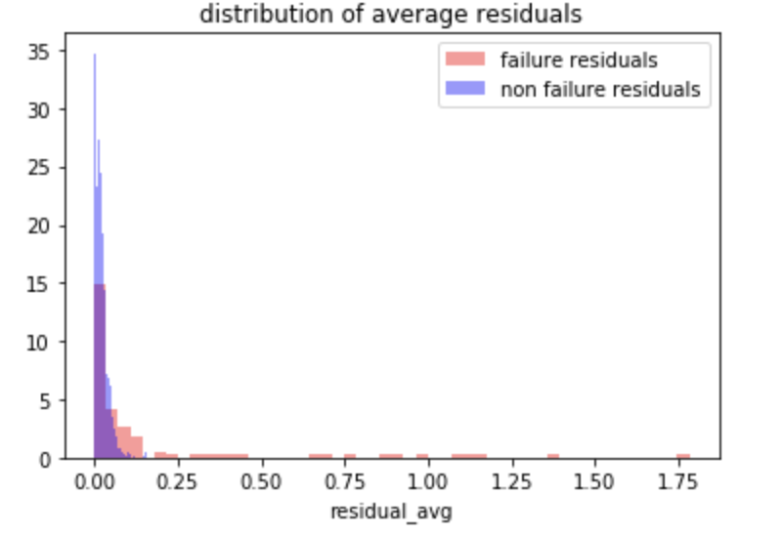
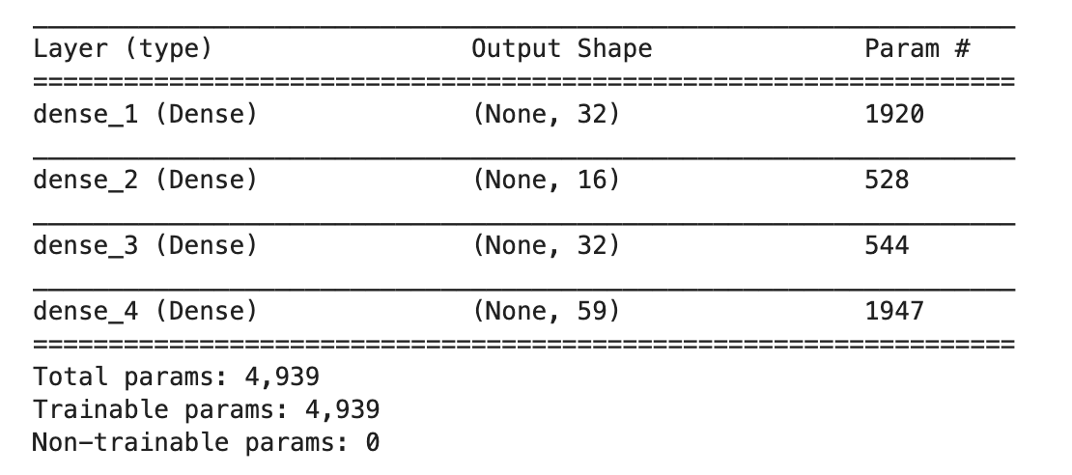
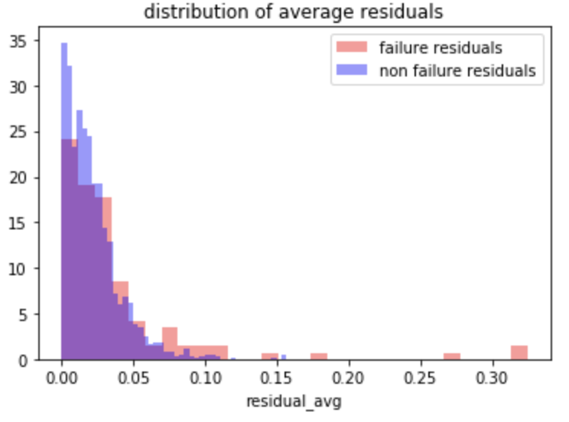
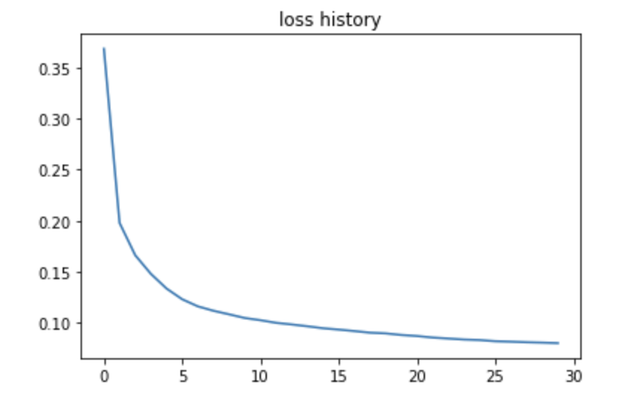
Preliminary Results
Average Reconstruction Error
Autoencoder weights – 5K params
Non failures
Failure – early interval = 1
Loss Curve (MSE)
Good convergence
Failure – early interval = 2
Training time = 1 second per epoch
Early interval = 1 shows better separation of failures and non-failures

Slide 12
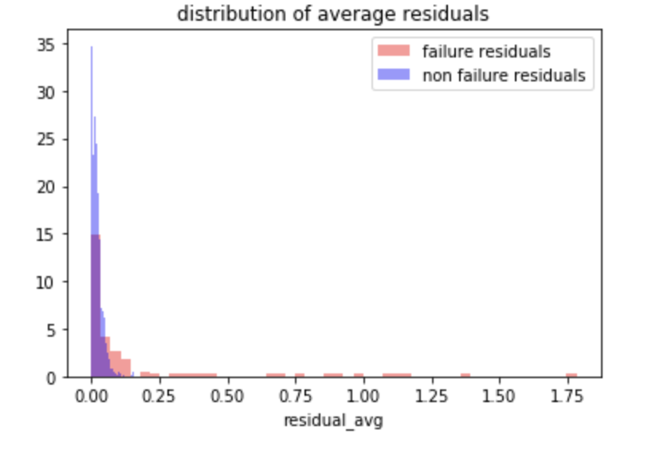
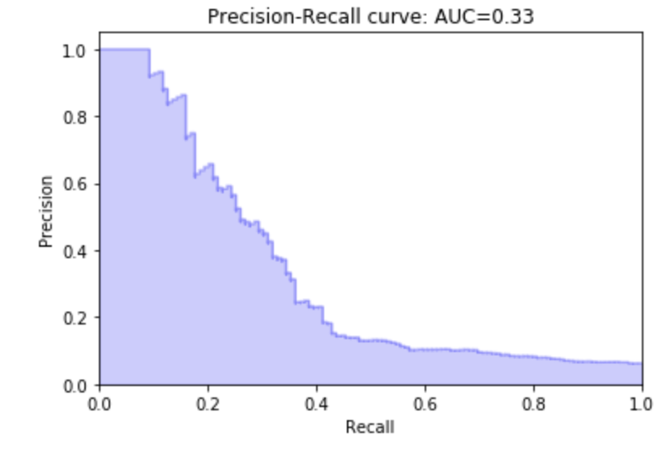
Comparison to XGBoost
Test Residuals
Threshold 3s
Failures
Thresholds calculated based on training data – 3 and 5 sigma
Perform classification based on threshold
Early prediction interval = 1
 | Logistic Regression | 3σ threshold | 5σ threshold
Topology | NA | 32-16-32 | 32-16-32
Precision | .51 | .554 | .84
Recall | .07 | .303 | .218
F1 Score | .11 | .391 | .347
ROC AUC | Not provided | .70
PR AUC | Not provided | .33
Autoencoders handles class imbalance better than XGB for this dataset

Slide 13
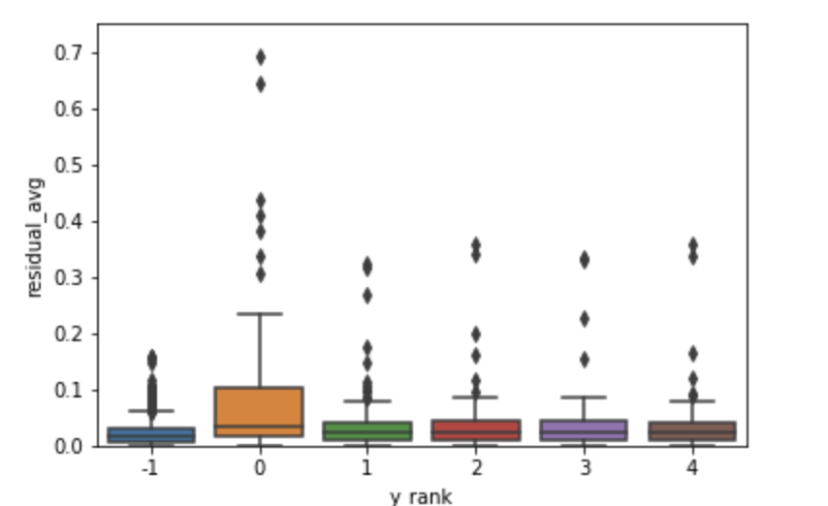
Residual distribution vs early prediction interval
Error distribution for early intervals
 | Early 1 | Early 2 | Early 3
F1 Score | .391 | .147 | .1
ROC AUC | .70 | .60 | .60
PR AUC | .33 | .12 | .10
Non
failures
Early = 1
Early = 2
Early = 3
Early = 4
Early = 5
Autoencoder’s capability deteriorates as early interval increases

Slide 14
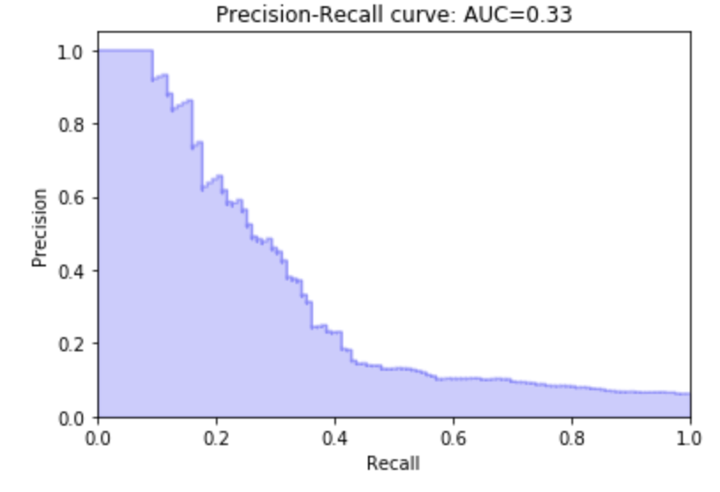
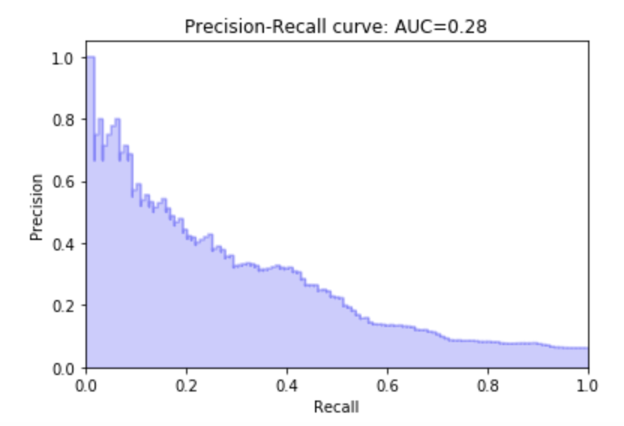
Different Feature Comparison
All 61 features
Threshold = 3 sigma training error
Early prediction interval = 1
Batch size = 12
Epochs = 50
Topology = tune for each feature set
Hidden Layer Shape | All features - 59 | Top 15 XGBoost Features
F1 Score | .391 | .192
ROC AUC | .70 | .66
PR AUC | .33 | .28
Top 15 features
Preliminary Feature selection did not improve model

Slide 15
Different Topology comparison
Threshold = 3 sigma training error
Early prediction interval = 1
Batch size = 12
Epochs = 50
 | Complex | Base Case | Simple
Topology | 32-16-8-16-32 | 32-16-32 | 16
F1 Score | .368 | .391 | .257
ROC AUC | .68 | .70 | .65
PR AUC | .30 | .33 | .23
3 Layer auto encoder performed the best

Slide 16
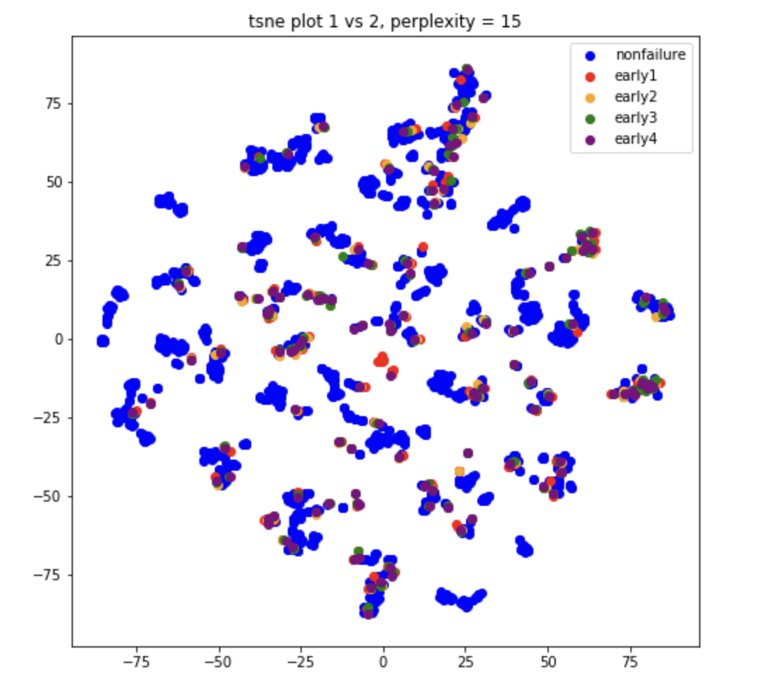
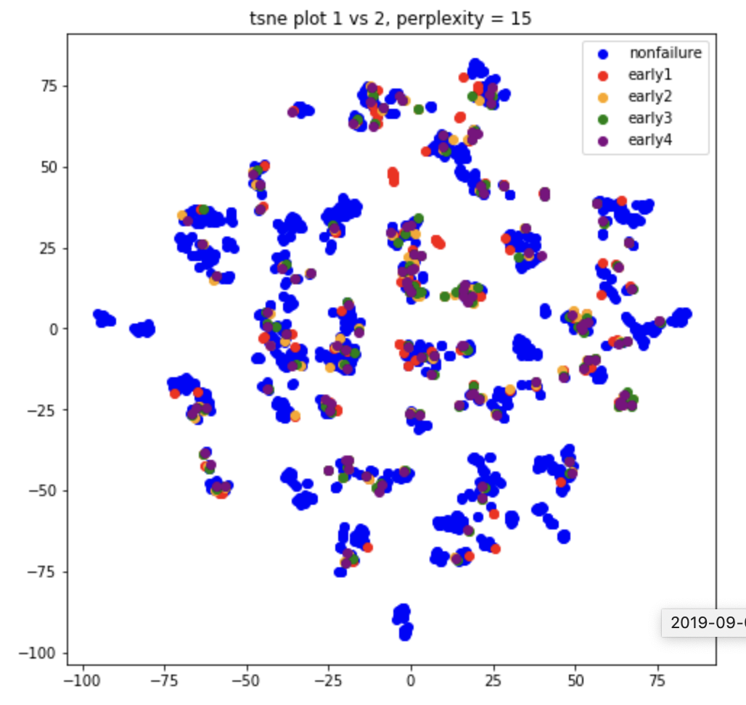
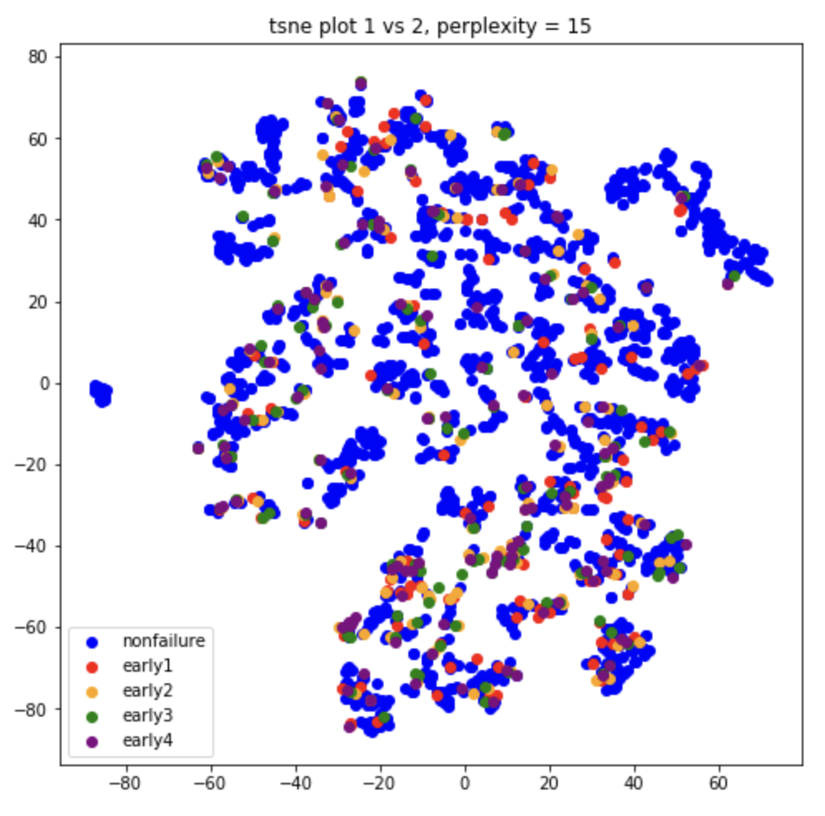
Visualization of encoded representation with t-sne
Sensor inputs
Encoded Data
Encoded Data – xgb selected features (top 15)
T-sne is not able to separate failures from non-failures

Slide 17
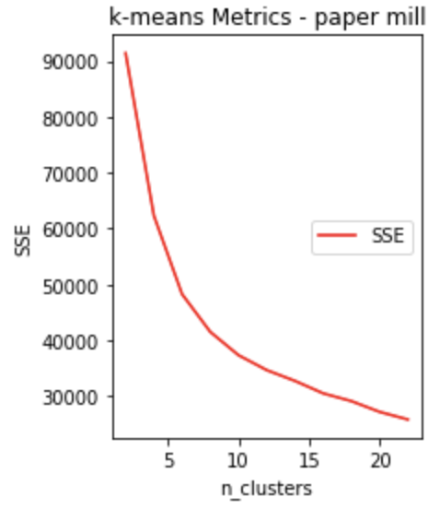
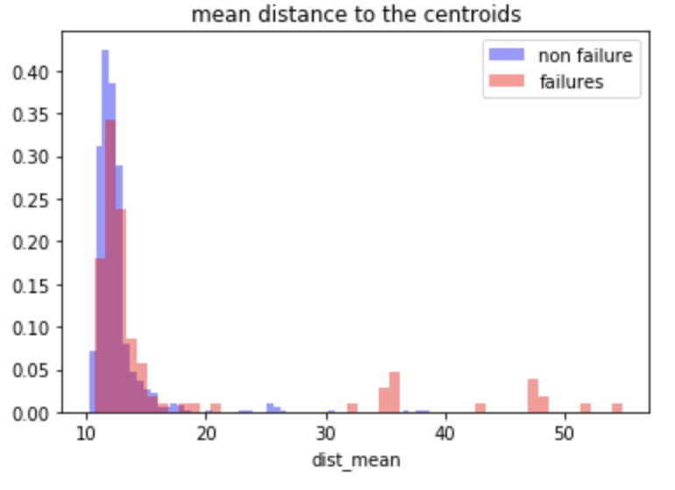
Comparison to K means clustering anomaly detection
Model Fitting
Step 1: Chose 5 clusters based on elbow plot for non-failures
Step 2: Fit 5 clusters on train data
* Find 3 sigma threshold for mean distance to cluster centroid
Model Testing
Step 3: Obtain average distance to centroids for test data (failures and non-failures)
Anomaly Detection
Step 4: Classify anomaly based on threshold for average distance to centroid
Early Interval = 1 | Autoencoder – 61 variables | Km - sensor inputs - 61 variables | Km - encoded outputs
F1 Score | .391 | .253 | .071
ROC AUC | .70 | .66 | .67
PR AUC | .33 | .24 | .10
K means on sensor-inputs performed slightly worse than autoencoder
K means on encodings performed very poorly

Slide 18
Additional Dataset Description
Machine Failure Dataset https://bigml.com/user/czuriaga/gallery/dataset/587d062d49c4a16936000810
9000 rows – 81 failures
17 sensor variables
Credit Card Fraud Dataset - https://www.kaggle.com/mlg-ulb/creditcardfraud
280K rows – 492 frauds
28 anonymous variables
IBM IOT dataset - https://developer.ibm.com/patterns/predict-equipment-failure-using-iot-sensor-data/
900 rows, 393 failures
9 sensors
Credit Card Default Dataset - https://archive.ics.uci.edu/ml/datasets/default+of+credit+card+clients
30000 rows, 6600 defaults
25 payment variables
Semiconductor Manufacturing - https://archive.ics.uci.edu/ml/machine-learning-databases/secom/
1500 rows, 100 failures
590 sensor variables

Slide 19
Appendix

